Slide 1
Optimus Octavian
Volvo CoPilot Safe Assist

Slide 2
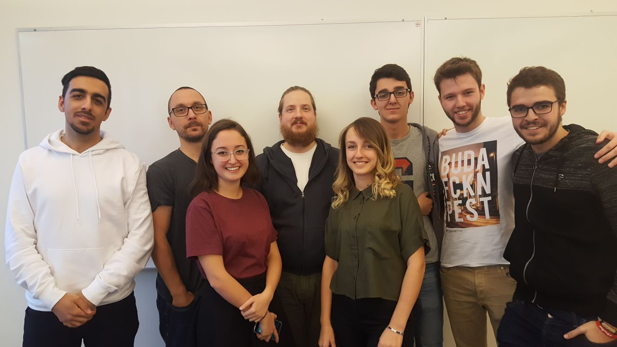
GROUP MEMBERS

Slide 3
Product description
Our client is Volvo
Android application
Aimes for CoPilot & workers devices
Safe Assist Alarm - when too close

Slide 4
TASK division
Vasja – Manager
Sidorela – Client Contact
Rickard – Configuration Manager (GIT Expert)
Alvaro – Document Master
Pablo – Configuration Manager (Trello Expert)
Jonas & Dara & Fernando – To Be Assigned
(not permanently assigned)

Slide 5
What is already done
Hard working introduction meeting
Introduction to members
Setting up the communication methods
Contacting the client and MDH contact

Slide 6
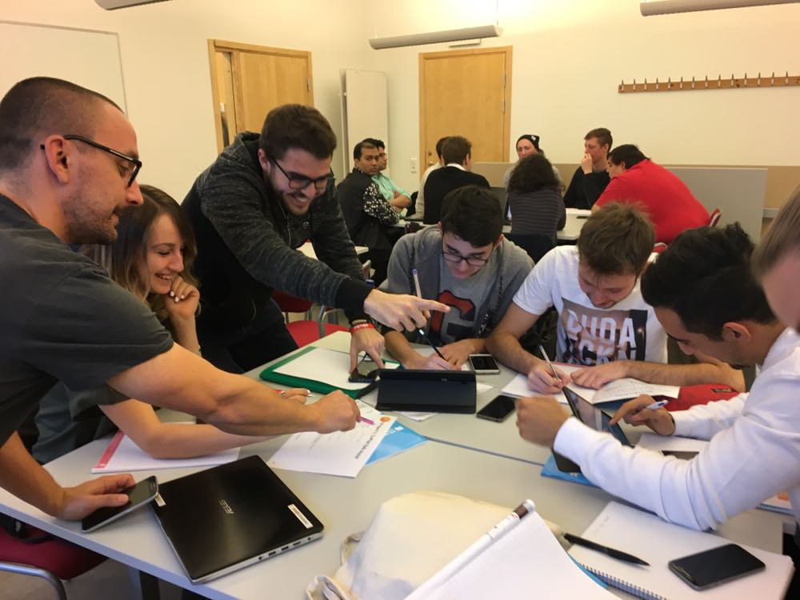

Slide 7
What is already done
Meeting with our MDH Contact
General overview of our project
Introduction to the device we shall be working on

Slide 8
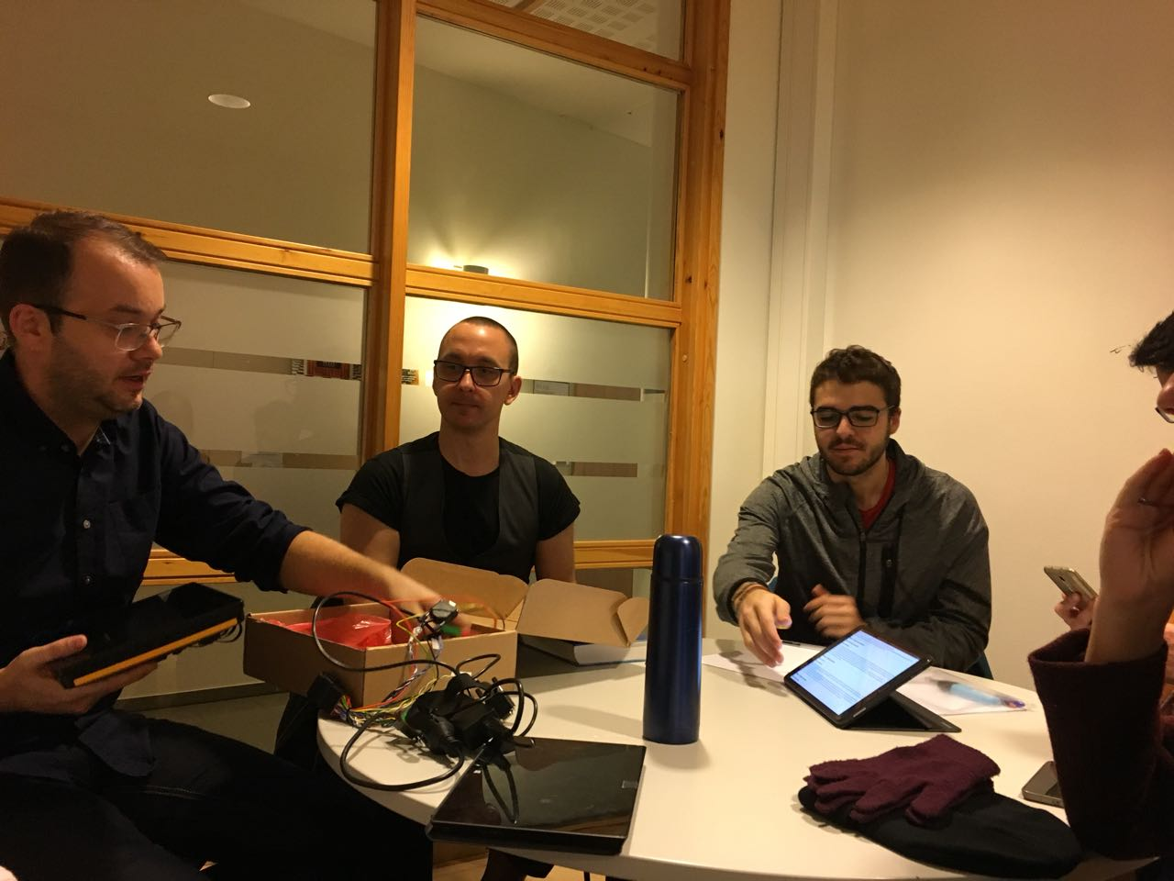

Slide 9
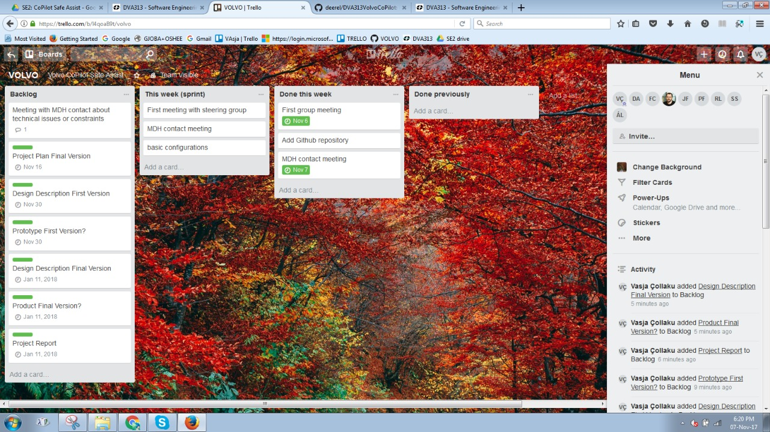
Starting with trello

Slide 10
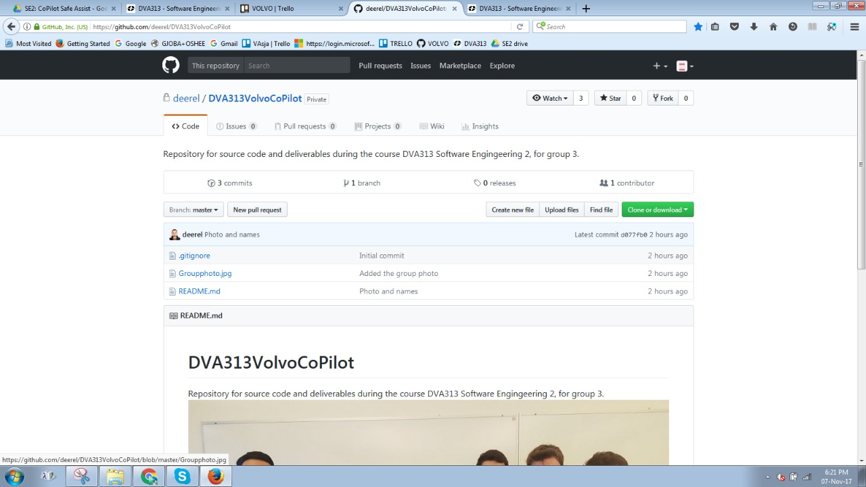
And with GitHub

Slide 11

What we have planned to do!
3. Meeting with the client at VOLVO HQ at Eskilstuna on Friday!

Slide 12

THANK YOU!

